Slide 1
Penny Web Hosting in AWS
Host Website in AWS for $1 or less a month
Nikki Yodo

Slide 2
Introduction
Experience: Software, DevOps, Cloud Ops engineer
Interests: Learning, Reading, Running, etc.
GitHub: https://github.com/nik-yo
LinkedIn: https://www.linkedin.com/in/nikkiyodo/
Consulting: www.nikyotech.com
Email: nikki.yodo@nikyotech.com

Slide 3
Motivation
Simple website
Quality: Durable hosting, robust features, battle tested
Time: Fast development and deployment
Cost: Affordable
Lowest web hosting cost is $2-$5 a month. Can we do better?

Slide 4
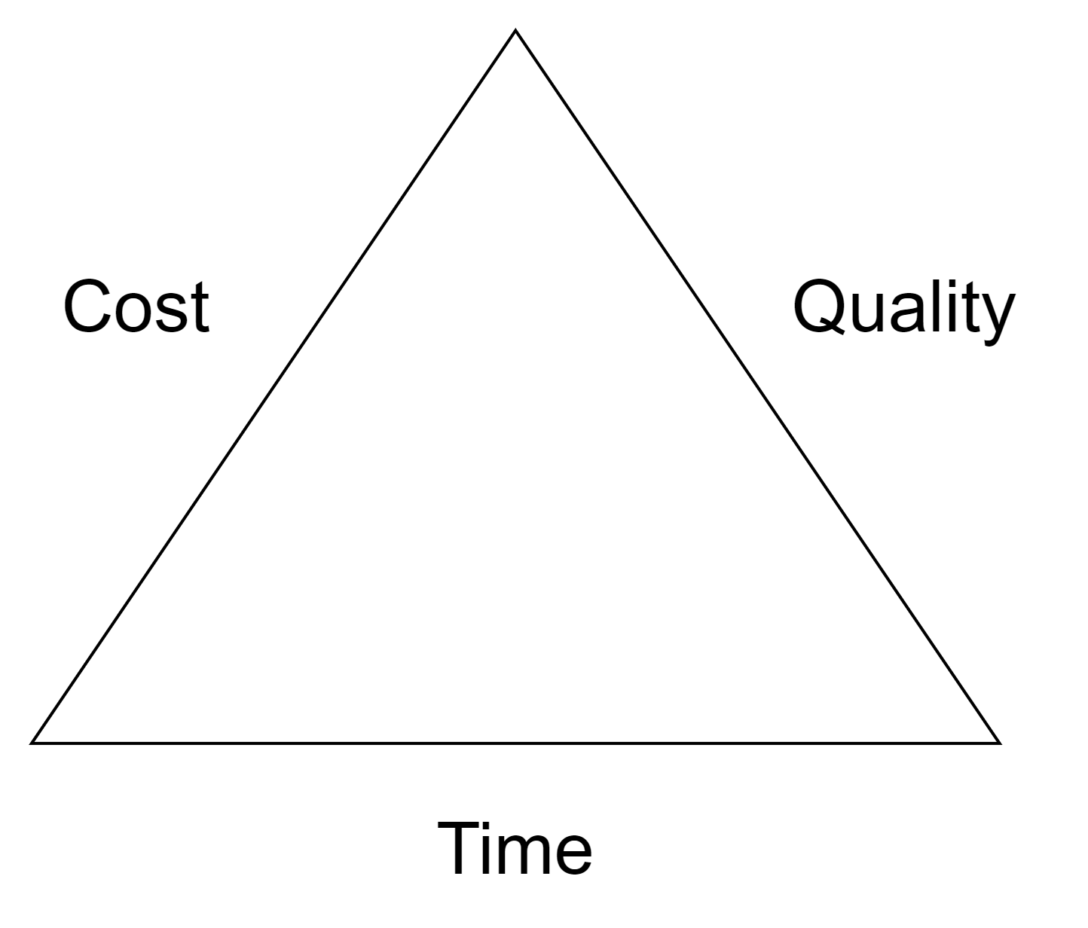
Iron Triangle

Slide 5
Stack
CloudFront
ACM for SSL Certificate
S3
SPA (Next.js)
GitHub
Route 53 Public Hosted Zone (optional)

Slide 6
Quality
CloudFront: 99.9% uptime
S3: 99.999999999% durability, 99.99% availability
Next.js
ReactJS/NodeJS based, wide community support
Support SSG (Static Site Generation) and SSR (Server Site Rendering)
SEO friendly
Built-in router (folder based)
Support Tailwind CSS (utility first) out of the box

Slide 7
Time
Development:
Application:
Next.js has a small learning curve
Tailwind CSS is easy to learn
Infrastructure:
IaC (CloudFormation, Terraform)
Deployment:
GitHub Action has small learning curve
Operational:
CloudFront caching
Static Files served by S3

Slide 8
Cost
CloudFront
Free tier:
1 TB of data transfer out to the internet per month
10,000,000 HTTP or HTTPS Requests per month
Paid tier:
First 10TB: $0.085
HTTP Requests: $0.0075 per 10,000 requests
HTTPS Requests: $0.0100 per 10,000 requests
ACM (SSL Certificate)
Public SSL/TLS certificates provisioned through AWS Certificate Manager (ACM) are free
S3
Free tier:
20,000 GET Requests
2,000 PUT, COPY, POST, or LIST Requests
100 GB of Data Transfer Out each month
Storage:
First 50 TB / Month: $0.023 per GB
Requests:
S3 Standard: $0.0004 per 1,000 GET requests
Data transfer:
First 10 TB / Month: $0.09 per GB
Public Hosted Zone (optional)
$0.50 per hosted zone per month for the first 25 hosted zones

Slide 9
Questions?

Slide 10
Backup Slides

Slide 11
Domain
CloudFlare
Pros:
No extra charge
Cons:
Have to use their DNS
Only need Route 53 for SSL cert validation which is one time setup.
Save $0.50 a month.

Slide 12
DevOps
GitHub + GitHub Action
Azure DevOps + Pipelines

Slide 13
Backend
Lambda
DynamoDB (on-demand)

